Slide 1



ASE 2023
LUXEMBOURG
Tegawendé F. Bissyandé & Jacques Klein

Slide 2
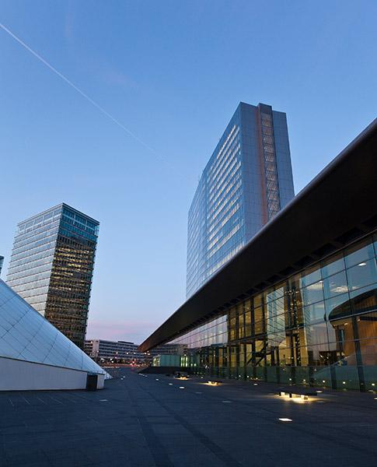
Progress Report #1
1) The date is decided:
11-15 September 2023 (Monday - Friday)
The main conference will be from Tue. to Thu.
Workshop days on Monday and Friday.
2) The venue has been booked.
The European Convention Center Luxembourg
https://www.eccl.lu/en/

Slide 3
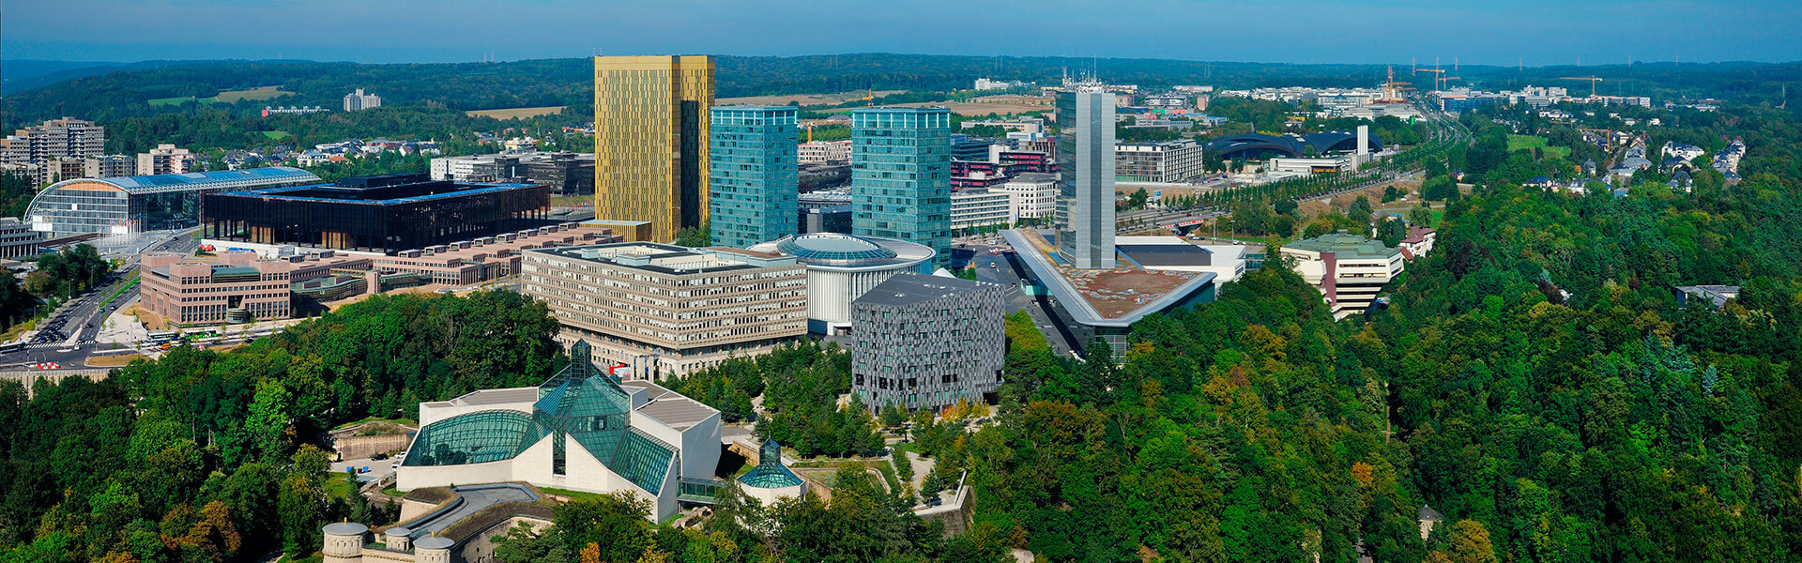

The European Convention Center Luxembourg

Slide 4
Progress Report #2
3) First IEEE Budget draft: DONE
We will send it for approval soon.
The budget is ok with 300 participants.
Fixed costs are covered by sponsorship => no risk
Question: Currently, sponsorship 50% for IEEE and 50% for ACM. Does the SC agree that we negotiate with IEEE to add the University of Luxembourg as co-sponsor?
4) We will invite chairs (Doctoral symposium, workshop, tutorial, etc.) before the end of the month

Slide 5
Progress Report #3
5) Program Committee Members and deadlines
PC Co-chairs: F. Sarro and C. Bird
PC members invitations will be sent soon
Late deadlines due to ICSE deadline end of March
Abstracts: April 27
Full paper: May 4
6) Social Events
Welcome Reception: private event in a pub
Gala Dinner: on a boat

Slide 6
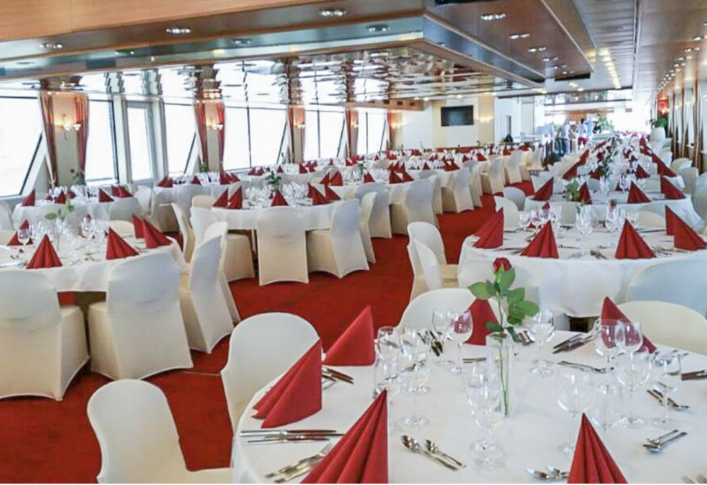
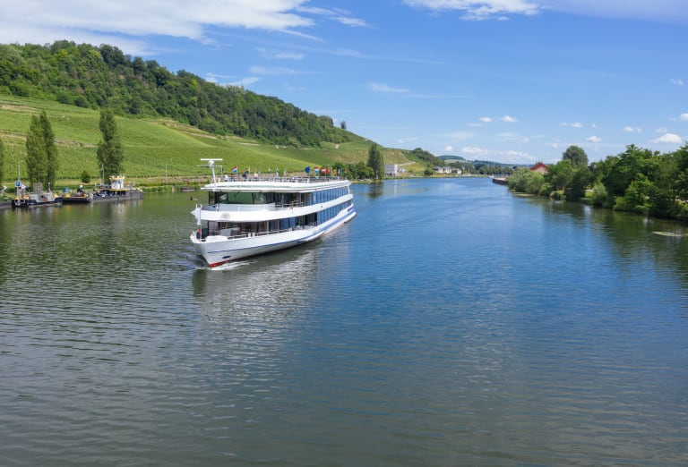
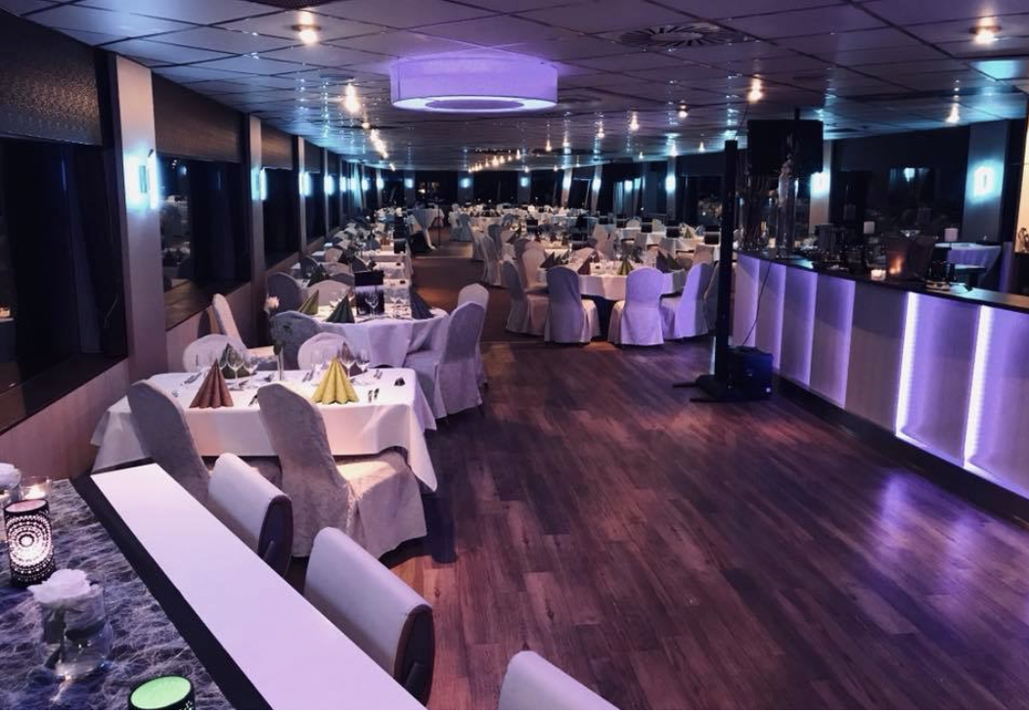

Slide 7
Pending?
ASE 2023 will be:
Virtual?
Hybrid?
Full in-person?

Slide 8

We are looking forward to hosting you in 2023!

